Slide 1
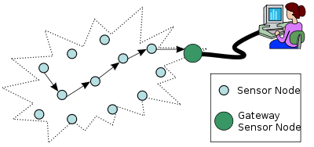
Wireless Sensor Networks
Notes:
<number>

Slide 2
Outline
Introduction
Sensor Network Architecture
Data Dissemination
Data Gathering
MAC Protocols for Sensor Networks
Location Discovery
Quality of a Sensor Network
Evolving Standards
Other Issues

Slide 3
Introduction
Sensor networks are highly distributed networks of small, lightweight wireless node, deployed in large numbers to monitor the environment or system.
Each node of the sensor networks consist of three subsystem:
Sensor subsystem: senses the environment
Processing subsystem: performs local computations on the sensed data
Communication subsystem: responsible for message exchange with
neighboring sensor nodes
The features of sensor nodes
Limited sensing region, processing power, energy

Slide 4
The advantage of sensor networks
Robust : a large number of sensors
Reliable :
Accurate : sensor networks covering a wider region
Fault-tolerant : many nodes are sensing the same event
Two important operations in a sensor networks
Data dissemination : the propagation of data/queries throughout the network
Data gathering : the collection of observed data from the individual sensor nodes to a sink
The different types of sensors
Seismic, thermal, visual, infrared

Slide 5
Applications of Sensor Networks
Using in military
Battlefield surveillance and monitoring, guidance systems of intelligent missiles, detection of attack by weapons of mass destruction such as chemical, biological, or nuclear
Using in nature
Forest fire, flood detection, habitat exploration of animals
Using in health
Monitor the patient’s heart rate or blood pressure, and sent regularly to alert the concerned doctor, provide patients a greater freedom of movement

Slide 6
Using in home (smart home)
Sensor node can built into appliances at home, such as ovens, refrigerators, and vacuum cleaners which enable them to interact with each other and be remote-controlled
Using in office building
Airflow and temperature of different parts of the building can be automatically controlled
Using in warehouse
Improve their inventory control system by installing sensors on the products to track their movement

Slide 7
Comparison with Ad Hoc Wireless Networks
Different from Ad Hoc wireless networks
The number of nodes in sensor network can be several orders of magnitude large than the number of nodes in an ad hoc network.
Sensor nodes are more easy to failure and energy drain, and their battery sources are usually not replaceable or rechargeable.
Sensor nodes may not have unique global identifiers (ID), so unique addressing is not always feasible in sensor networks.
Sensor networks are data-centric, the queries in sensor networks are addressed to nodes which have data satisfying some conditions. Ad Hoc networks are address-centric, with queries addressed to particular nodes specified by their unique address.
Data fusion/aggregation: the sensor nodes aggregate the local information before relaying.

Slide 8
Issues and Challenges in Designing a Sensor Network
Issues and Challenges
Sensor nodes are randomly deployed and hence do not fit into any regular topology. Once deployed, they usually do not require any human intervention. Hence, the setup and maintenance of the network should be entirely autonomous.
Sensor networks are infrastructure-less. Therefore, all routing and maintenance algorithms need to be distributed.
Energy problem
Hardware and software should be designed to conserve power

Slide 9
Issues and Challenges in Designing a Sensor Network
Sensor nodes should be able to synchronize with each other in a completely distributed manner.
A sensor network should also be capable of adapting to changing connectivity due to the failure of nodes, or new nodes powering up. The routing protocols should be able to dynamically include or avoid sensor nodes in their paths.

Slide 10
Issues and Challenges in Designing a Sensor Network
Real-time communication over sensor networks must be supported through provision of guarantees or QoS parameters.
Provision must be made for secure communication over sensor networks, especially for military applications which carry sensitive data.

Slide 11
Sensor Network Architecture
The two basic kinds of sensor network architecture
Layered Architecture
Clustered Architecture

Slide 12
Layered Architecture
A layered architecture has a single powerful base station, and the layers of sensor nodes around it correspond to the nodes that have the same hop-count to the BS.
BS acts an access point to a wired network, and small nodes form a wireless backbone to provide wireless connectivity.
The advantage of a layered architecture is that each node is involved only in short-distance, low-power transmissions to nodes of the neighboring layers.

Slide 13
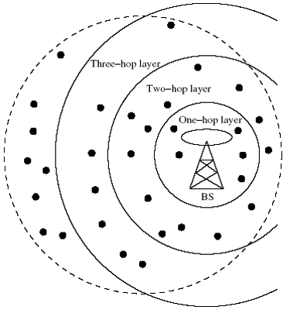
Layered architecture

Slide 14
Unified Network Protocol Framework (UNPF)
UNPF is a set of protocols for complete implementation of a layered architecture for sensor networks
UNPF integrates three operations in its protocol structure:
Network initialization and maintenance
MAC protocol
Routing protocol

Slide 15
Network initialization and maintenance
The BS broadcasts its ID using a known CDMA code on the common control channel.
All node which hear this broadcast then record the BS ID. They send a beacon signal with their own IDs at their low default power levels.
Those nodes which the BS can hear form layer one
BS broadcasts a control packet with all layer one node IDs. All nodes send a beacon signal again.
The layer one nodes record the IDs which they hear (form layer two) and inform the BS of the layer two nodes IDs.
Periodic beaconing updates neighbor information and change the layer structure if nodes die out or move out of range.

Slide 16
MAC protocol
During the data transmission phase, the distributed TDMA receiver oriented channel (DTROC) assignment MAC protocol is used.
Two steps of DTROC :
Channel allocation : Each node is assigned a reception channel by the BS, and channel reuse is such that collisions are avoided.
Channel scheduling : The node schedules transmission slots for all its neighbors and broadcasts the schedule. This enables collision-free transmission and saves energy, as nodes can turn off when they are not involved on a send/receive operation.

Slide 17
Routing protocol
Downlink from the BS is by direct broadcast on the control channel. Uplink from the sensor nodes to BS is by multi-hop data forwarding.
The node to which a packet is to be forwarded is selected considering the remaining energy of the nodes. This achieves a higher network lifetime.

Slide 18
UNPF-R
Optimize the network performance by making the sensor nodes adaptively vary their transmission range.
Because while a very small transmission range cause network partitioning, a very large transmission range reduce the spatial reuse of frequencies.
The optimal range (R) is determined by simulated annealing
Objective function : f(R)=(E*d)/(n/N)
N : the total number of sensors
n : the number of nodes in layer one
E : the energy consumption per packet
d : the average packet delay

Slide 19
Clustered Architecture
A clustered architecture organizes the sensor nodes into clusters, each governed by a cluster-head. The nodes in each cluster are involved in message exchanges with their cluster-heads, and these heads send message to a BS.
Clustered architecture is useful for sensor networks because of its inherent suitability for data fusion. The data gathered by all member of the cluster can be fused at the cluster-head, and only the resulting information needs to be communicated to the BS.
The cluster formation and election of cluster-heads must be an autonomous, distributed process.

Slide 20
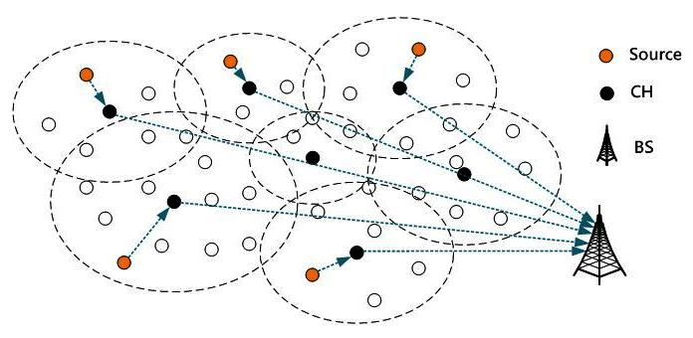
Clustered architecture

Slide 21
Low-Energy Adaptive Clustering Hierarchy (LEACH)
LEACH is a clustering-based protocol that minimizes energy dissipation in sensor networks. The operation of LEACH is spilt into two phases : setup and steady.
Setup phase : each sensor node chooses a random number between 0 and 1. If this is lower than the threshold for node n, T(n), the sensor node becomes a cluster-head. The threshold T(n) is calculated as
T(n)=P/1-P*(r mod P) , n element of G
P : the percentage of nodes which are cluster-heads
r : the current round
G : the set of nodes that has not been cluster-heads in the past 1/.P rounds

Slide 22
After selection, the cluster-heads advertise their selection to all nodes. All nodes choose their nearest cluster-head by signal strength . The cluster-heads then assign a TDMA schedule for their cluster members.
Steady phase : data transmission takes place based on the TDMA schedule, and the cluster-heads perform data aggregation/fusion.
After a certain period of time in the steady phase, cluster-heads are selected again through the setup phase.

Slide 23
Data Dissemination
Data dissemination is the process by which queries or data are routed in the sensor network. The data collected by sensor nodes has to be communicated to the nodes which are interested in the data.
The node that generates data is call source and the information to be reported is called an event. A node which is interested in an event is called sink.
Data dissemination consist of a two-step process : interest propagation and data propagation.
Interest propagation : for every event that a sink is interested in, it broadcasts its interest to is neighbor, and across the network.
Data dissemination : When an event is detected, it reported to the interested nodes (sink).

Slide 24
Flooding
Each node which receives a packet (queries/data) broadcasts it if the maximum hop-count of the packet is not reached and the node itself is not the destination of the packet.
Disadvantages :
Implosion : this is the situation when duplicate messages are send to the same node. This occurs when a node receives copies of the same messages from many of its neighbors.
Overlap : the same event may be sensed by more than one node due to overlapping regions of coverage. This results in their neighbors receiving duplicate reports of the same event.
Resource blindness : the flooding protocol does not consider the available energy at the nodes and results in many redundant transmissions. Hence, it reduces the network lifetime.

Slide 25
Gossiping
Modified version of flooding
The nodes do not broadcast a packet, but send it to a randomly selected neighbor.
Reduces the problem of implosion
It takes a long time for message to propagate throughout the network.
It does not guarantee that all nodes of network will receive the message.

Slide 26
Rumor Routing
Agent-based path creation algorithm
Agent is a long-lived packet created at random by nodes, and it will die after visit k hops.
It is circulated in the network to establish shortest paths to events that they encounter.
When an agent finds a node whose path to an event is longer than its own, it updates the node’s routing table.

Slide 27
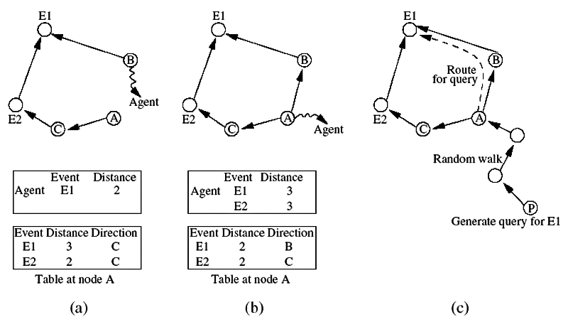
Rumor routing

Slide 28
Sequential Assignment Routing (SAR)
The sequential assignment routing (SAR) algorithm creates multiple trees, where the root of each tree is a one-hop neighbor of the sink.
Each sensor node records two parameters about each path though it : available energy resources on the path and an additive QoS metric such as delay.
Higher priority packets take lower delay paths, and lower priority packets have to use the paths of greater delay, so that the priority X delay QoS metric is maintained.

Slide 29
Directed Diffusion
The directed diffusion protocol is useful in scenarios where the sensor nodes themselves generate requests/queries for data sensed by other nodes.
Each sensor node names its data with one or more attributes.
Each sensor node express their interest depending on these attributes.
Each path is associated with a interest gradient, while positive gradient make the data flow along the path, negative gradient inhibit the distribution data along a particular path.

Slide 30
Cost-Field Approach
The cost-field approach considers the problem of setting up paths to a sink. The first phase being to set up the cost field, based on metrics such as delay. The second phase being data dissemination using the costs.
A sink broadcasts an ADV packet with its own cost as 0.
When a node N hears an ADV message from node M, it sets its own path cost to min (L_{N},L_{M}+C_{NM}), where L_{N} is the total path cost from node N to the sink, L_{M} is the cost of node M to the sink, C_{NM} is the cost from N to M.
If L_{N} is updated, the new cost is broadcast though another ADV.
The back-off time make a node defer its ADV instead of immediately broadcast it. The back-off time is r x C_{MN}, where r is a parameter of algorithm.

Slide 31
Geographic Hash Table (GHT)
GHT hashes keys into geographic coordinates and stores a (key, value) pair at the sensor node nearest to the hash value.
Stored data is replicated to ensure redundancy in case of node failures.
The data is distributed among nodes such that it is scalable and the storage load is balanced.

Slide 32
Data Gathering
The objective of the data gathering problem is to transmit the sensed data from each sensor node to a BS.
The goal of algorithm which implement data gathering is
maximize the lifetime of network
Minimum energy should be consumed
The transmission occur with minimum delay
The energy X delay metric is used to compare algorithm

Slide 33
Direct Transmission
All sensor nodes transmit their data directly to the BS.
It is cost expensive when the sensor nodes are very far from the BS.
Nodes must take turns while transmitting to the BS to avoid collision, so the media access delay is also large. Hence, this scheme performs poorly with respect to the energy x delay metric.

Slide 34
Power-Efficient Gathering for Sensor Information Systems
PEGASIS based on the assumption that all sensor nodes know the location of every other node.
Any node has the required transmission range to reach the BS in one hop, when it is selected as a leader.
The goal of PEGASIS are as following
Minimize the distance over which each node transmit
Minimize the broadcasting overhead
Minimize the number of messages that need to be sent to the BS
Distribute the energy consumption equally across all nodes
To construct a chain of sensor nodes, starting from the node farthest from the BS. At each step, the nearest neighbor which has not been visited is added to the chain.
It is reconstructed when nodes die out.

Slide 35
At every node, data fusion or aggregation is carried out.
A node which is designated as the leader finally transmits one message to the BS.
Leadership is transferred in sequential order.
The delay is O(N)

Slide 36
Binary Scheme
This is a chain-based scheme like PEGASIS, which classifies nodes into different levels.
This scheme is possible when nodes communicate using CDMA, so that transmissions of each level can take place simultaneously.
The delay is O(logN)
本圖取自"Ad Hoc Wireless Networks", by C. Siva Ram Murthy and B. S. Manoj, published by Prentice Hall, 2004

Slide 37
Chain-Based Three-Level Scheme
For non-CDMA sensor nodes
The chain is divided into a number of groups to space out simultaneous transmissions in order to minimize interference.
Within a group, nodes transmit data to the group leader, and the leader fusion the data, and become the member to the next level.
In the second level, all nodes are divided into two groups.
In the third level, consists of a message exchange between one node from each group of the second level.
Finally, the leader transmit a single message to the BS.

Slide 38
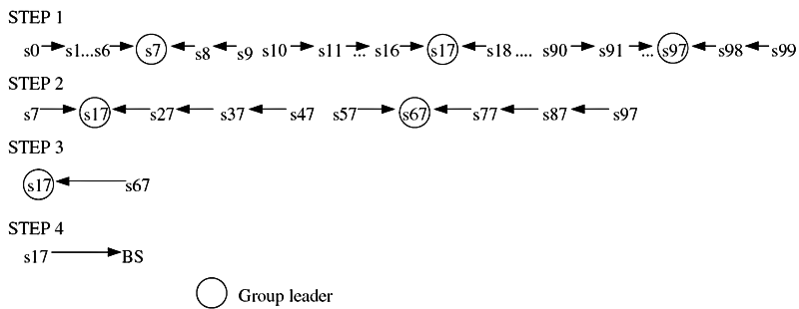
Chain-based three-level scheme
本圖取自"Ad Hoc Wireless Networks", by C. Siva Ram Murthy and B. S. Manoj, published by Prentice Hall, 2004

Slide 39
MAC Protocols for Sensor Networks
The challenges posed by sensor network MAC protocol
No single controlling authority, so global synchronization is difficult
Power efficiency issue
Frequent topology changes due to mobility and failure
There are three kinds of MAC protocols used in sensor network:
Fixed-allocation
Demand-based
Contention-based

Slide 40
Fixed-allocation MAC protocol
Share the common medium through a predetermined assignment.
It is suitable for sensor network that continuously monitor and generate deterministic data traffic
Provide a bounded delay for each node
However, in the case of bursty traffic, where the channel requirements of each node may vary over time, it may lead to inefficient usage of the channel.

Slide 41
Demand-based MAC protocol
Used in such cases, where the channel is allocated according to the demand of the node
Variable rate traffic can be efficiently transmitted
Require the additional overhead of a reservation process
Contention-based MAC protocol
Random-access-based contention for the channel when packets need to be transmitted
Suitable for bursty traffic
Collisions and no delay guarantees, are not suitable for delay-sensitive or real-time traffic

Slide 42
Self-Organizing MAC for Sensor Networks and
Eavesdrop and Register
Self-Organizing MAC for sensor (SMACS) networks and eavesdrop and register (EAR) are two protocols which handle network initialization and mobility support, respectively.
In SMACS
neighbor discovery and channel assignment take place simultaneously in a completely distributed manner.
A communication link between two nodes consists of a pair of time slots, at fixed frequency.
This scheme requires synchronization only between communicating neighbors, in order to define the slots to be used for their communication.
Power is conserved by turning off the transceiver during idle slots.

Slide 43
In EAR protocol
Enable seamless connection of nodes under mobile and stationary conditions.
This protocol make use of certain mobile nodes, besides the existing stationary sensor nodes, to offer service to maintain connections.
Mobile nodes eavesdrop on the control signals and maintain neighbor information.

Slide 44
Hybrid TDMA/FDMA
A pure TDMA scheme minimize the time for which a node has to be kept on, but the associated time synchronization cost are very high.
A pure FDMA scheme allots the minimum required bandwidth for each connection
If the transmitter consumes more power, a TDMA scheme is favored, since it can be switch off in idle slots to save power.
If the receiver consumes greater power, a FDMA scheme is favored, because the receiver need not expend power for time synchronization.

Slide 45
CSMA-Base MAC Protocols
CSMA-based schemes are suitable for point-to-point randomly distributed traffic flows.
The sensing periods of CSMA are constant for energy efficiency, while the back-off is random to avoid repeated collisions.
Binary exponential back-off is used to maintain fairness in the network.
Use an adaptive transmission rate control (ARC) to balance originating traffic and route-through traffic in nodes. This ensures that nodes closer to the BS are not favored over farther nodes.
CSMA-based MAC protocol are contention-based and are designed mainly to increase energy efficiency and maintain fairness.

Slide 46
Location Discovery
During aggregation of sensed data, the location information of sensors must be considered.
Each nodes couple its location information with the data in the messages it sends.
GPS is not always feasible because it cannot reach nodes in dense foliage or indoor, and it consumes high power
We need a low-power, inexpensive, and reasonably accurate mechanism.

Slide 47
Indoor Localization
Fixed beacon nodes are placed in the field of observation, such as within building.
The randomly distributed sensors receive beacon signals from the beacon nodes and measure the signal strength, angle of arrival, time difference between the arrival of different beacon signals.
The nodes estimate distances by looking up the database instead of performing computations.
Only the BS may carry the database.

Slide 48
Sensor Network Localization
In situations where there is no fixed infrastructure available, some of the sensor nodes themselves act as beacons.
Using GPS, the beacon nodes have their location information, and send periodic beacons signal to other nodes.
In the case of communication using RF signals, the received signal strength indicator (RSSI) can be used to estimate the distance.
The time difference between beacon arrivals from different nodes can be used to estimate location.
Multi-lateration (ML) techniques
Atomic ML
Iterative ML
Collaborative ML

Slide 49
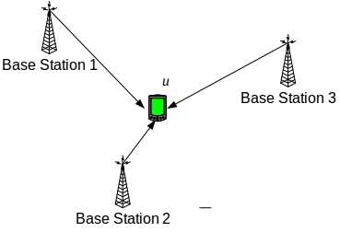
Atomic multi-lateration

Slide 50
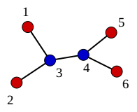
Iterative multi-lateration

Slide 51
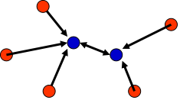
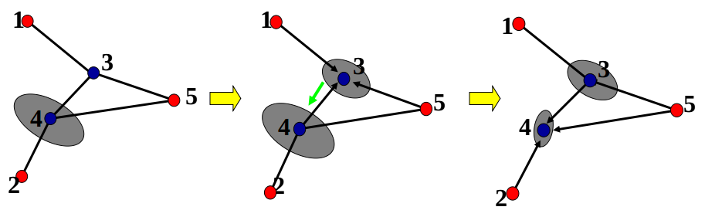
Collaborative multi-lateration

Slide 52
A mathematical technique called multi-dimensional scaling (MDS), an O(n³) algorithm, is used to assign location to node such that the distance constraints are satisfied.
To obtain the shortest distance between each pair of node.
If the actual positions of any three nodes in the network are known, then the entire network can be normalized.

Slide 53
Quality of a Sensor Network
The purpose of a sensor network is to monitor and report events take place in a particular area.
Hence, the main parameters which define how well the network observes a given area “coverage” and “exposure”.

Slide 54
Coverage
Coverage is a measure of how well the network can observe or cover an event.
The worst-case coverage defines area of breach, where coverage is the poorest. This can used to improve the deployment of network.
The best-case coverage defines the areas of best coverage. A path along the areas of best coverage is called maximum support path or maximum exposure path.
The coverage problem defined as follows:
A : a field with a set of sensors
S : {s1, s2, …, sn}, where for each sensor si in S
(xi, yi) : location coordinate
I : initial locations of an event
F: final locations of an event

Slide 55
Worst-case
The problem is to identify PB, the maximal breach path from I to F.
PB is defined as the locus of points p in the region A, where p is in PB if the distance from p to the closest sensor is maximized.
Voronoi diagram : partitioning the plane into a set of convex polygon such that all points inside a polygon are closest to the site (sensor) enclosed by the polygon.
The algorithm to find the breach path PB is:
Generate the Voronoi diagram
Create a weighted graph, the weight of each edge in the graph is the minimum distance from all sensors in S.
Determine the maximum cost path from I to F, using BFS.

Slide 56
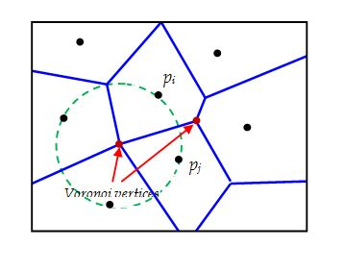
Voronoi diagram

Slide 57
Best-case
The problem is to identify PS, the maximum support path from I to F.
Delaunay triangulation, which is obtained from Voronoi diagram by connecting the sites whose polygons share a common edge.
The algorithm to find the breach path PS is:
Generate the Voronoi diagram
Generate the Delaunay triangulation
Create a weighted graph, the weight of each edge in the graph is the line segment lengths.
Determine the maximum cost path from I to F, using BFS.

Slide 58
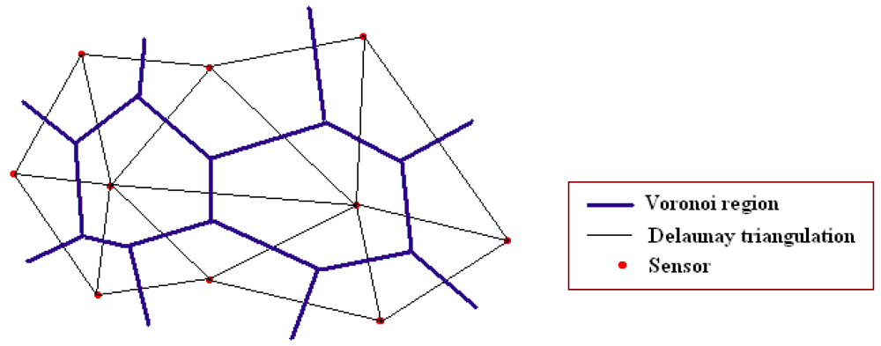
Delaunay triangulation

Slide 59
Exposure
Exposure is defined as the expected ability of observing a target in the sensor field.
The sensing power of a node s at point p is modeled as
S(s,p)=λ/[d(s,p)]^k
λand k are constant
d(s,p) is the distance of p from s
All-sensor field intensity :
I A ( F , p ) = ∑ S ( s i , p )
The closest sensor field intensity :
s min = s m ∈ S| d ( s m , p ) ≤ d ( s , p ) ∀ s ∈ S
I C ( F , p ) = S ( s min , p )

Slide 60
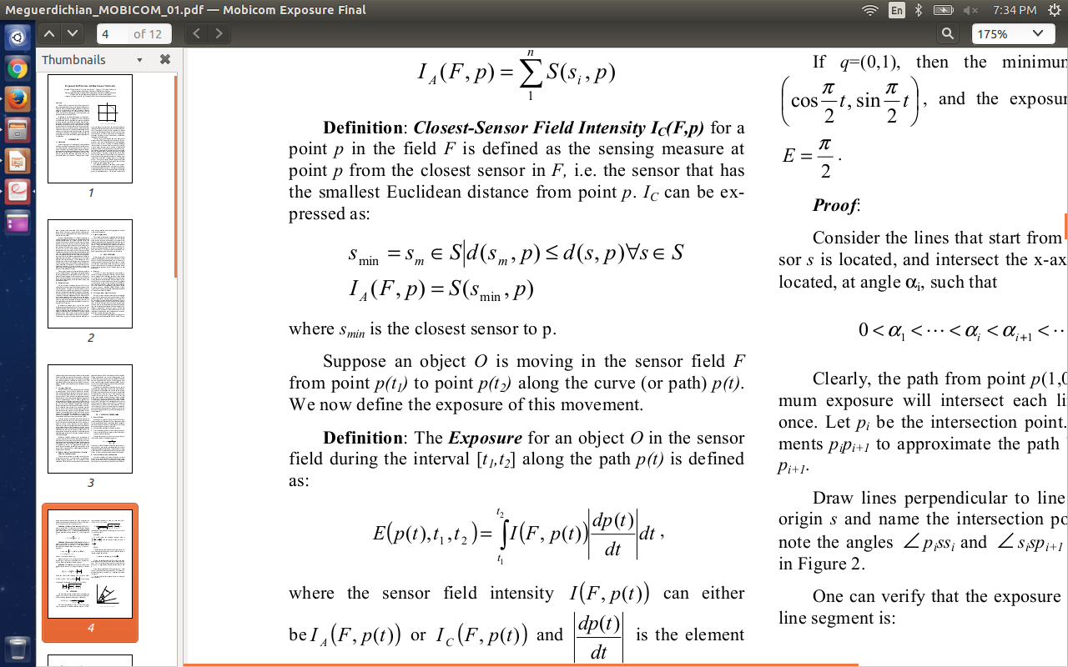
The exposure during travel of an event along a path p(t) is defined by the exposure function
E ( p ( t ), t 1 , t 2 ) = ∫ I ( F , p ( t ) |dp (t )/dt | dt
dp ( t )/dt is the elemental arc length, and t1,t2 are the time instance between which the path is traversed.

Slide 61
Evolving Standards
The IEEE 802.15.4 low-rate wireless personal area network (LR-WPAN) standard research a low data rate solution with multi-year battery life and very low complexity.
It intended to operate in an unlicensed, international frequency band. The eighteenth draft of this standard was accepted in MAY 2003.
This standard define the physical and MAC layer specifications for sensor and other WPAN networks. Low power consumption is an important feature targeted by the standard. This requires reduced transmission rate, power efficient modulation techniques, and strict power management techniques such as sleep modes.
Other standard, SensIT project by DARPA which focuses on large distributed military system.

Slide 62
Other Issues
Energy-Efficient Design
Synchronization
Transport Layer Issues
Security
Real-Time Communication

Slide 63
Energy-Efficient Design
In node level :
Dynamic power management (DMP)
One of the basic DMP is to shut down several component of the sensor node when no events take place.
Dynamic voltage scaling (DVS)
The processor has a time-varying computational load, hence the voltage supplied to it can be scaled to meet only the instantaneous processing requirement.
The real-time task scheduler should actively support DVS by predicting the computation and communication loads.
Sensor applications can also be trade-off between energy and accuracy.

Slide 64
In network level :
The computation-communication trade-off determines how much local computation is to be performed at each node and what level of aggregated data should be communicated to neighbor node or BSs.
Traffic distribution and topology management algorithms use the redundancy in the number of sensor nodes to use alternate routes so that energy consumption all over the network is nearly uniform.

Slide 65
Synchronization
Two major kinds of synchronization algorithms :
Long-lasting global synchronization , (for entire network lifetime)
Short-lived synchronization, (only for an instant)
Synchronization protocols typically involve delay measurements of control packets. The delay experienced during a packet transmission can be split into four major components :
Send time : sender to construct message
Access time : taken by the MAC layer to access the medium
Propagation time : taken by the bit to be physically transmitted through the medium over the distance separating the sender and receiver
Receive time : receiver receive the message from the channel

Slide 66
Global synchronization protocol
Based on exchange of control signals between neighbor nodes.
A node becomes a leader by election
The leader periodically send synchronization messages to its neighbor, and these message are broadcast in turn to all nodes of network
Fault-tolerance techniques have been added to account for errors on the synchronization message

Slide 67
A low-power synchronization scheme
The clocks of the nodes are normally unsynchronized
When event is observed, a synchronization pulse is broadcast by a beacon node
Offer short-lived synchronization, creating only an “instant” of synchronization among the nodes which are within transmission range of the beacon node.
The propagation delay of the synchronization pulse is assumed to be the same for all nodes.

Slide 68
Transport Layer Issues
Reliable data delivery
Pump slowly fetch quickly (PSFQ)
Event-to-sink reliable transport (ESRT)

Slide 69
Pump slowly fetch quickly (PSFQ)
PSFQ assumes that data loss is due to poor link rather than traffic congestion
The key concept :
Source node distributes data at a slow rate (pump slowly)
Receiver node which experiences data loss retrieve the missing data from immediate neighbors quickly
PSFQ consist of three functions :
Message relaying (pump)
Error recovery (fetch)
Selective status reporting (report)

Slide 70
Pump
Disseminates data to all target nodes, perform flow control, and localizes loss by ensuring caching at intermediate nodes
Hence, the errors on one link are corrected locally without propagating them down the entire path
Fetch
If receiver detect the loss of sequence numbers, it goes into fetch mode
It requests a retransmission from neighbor nodes
Many message losses are batched into a single fetch, which is especially suit for bursty losses.
Report
The farthest target node initiates its report on reverse path of data, and all intermediate nodes add their report
Hence, PSFQ ensure that data segment are delivery to all intended receiver in a scalable and reliable manner

Slide 71
Event-to-sink reliable transport (ESRT)
Event-to-sink reliability in place of end-to-end reliability by the transport layer
The sink is required to track reliably only the collective report about the event and not individual reports from each sensor
Observed reliability :
the number of packets that are routed from event to sink
Required reliability :
The desired number of packets for the event to be successfully track
If observed reliability < required reliability ,ESRT increase report freq
Otherwise, decrease the reporting freq for saving energy

Slide 72
Security
The Sybil attack
When a single node presents itself as multiple entities to the network. This can affect the fault tolerance of the network and mislead geographic routing algorithms.
A selective forwarding attack
When certain nodes do not forward any of messages they receive
Sinkhole attack
A node act as BS or a very favorable to the routing
And do not forward any of messages it receive

Slide 73
Wormhole attack
Make the traffic through a very long path by giving false information to the node about the distance between them.
Increase latency
Hello flood attack
Broadcast a Hello packet with very high power, so that a large number of node even far away in the network choose it as the parent.
Increase delay

Slide 74
Real-Time Communication
Used for surveillance or safety-critical system
Nuclear power plant
Two protocol which support real-time communication in sensor network:
SPEED
RAP

Slide 75
SPEED
Provide real-time packet transmission
Do not require routing table
Distributes traffic and load equally across the network
SPEED require periodic beacon transmission between neighbor
Use two on-demand beacons for delay estimation and congestion detection.
Routing of packets is performed by stateless non-deterministic geographic forwarding (SNGF). Using geographic information, packet are forwarded only to the nodes which are closer to the destination.
Among the closer nodes, the ones which have least delay have a higher probability of being chosen.
If there is no nodes that satisfy the delay constraint, the packet is dropped. And reduce the sending rate to avoid congestion, until the delay is below the average.

Slide 76
RAP
The application layer program in the BS can specify the kind of event information required, the area to which the query is addressed, and the deadline within which information is required.
The underlying layers of RAP ensure that the query is sent to all nodes in the specified area, and results are sent back to the BS.
Consist of location address protocol (LAP) , velocity monotonic scheduling (VMS)
LAP use location to address nodes instead of IP. It supports three kind of communication: unicast, area multicast, area anycast.
VMS is based on the concept of packet-requested velocity, which reflect both the timing and the distance constraint. The velocity of a packet is calculated as the ratio of the geographic distance between sender and receiver.

